Slide 1
Learning Risk-Aware Policies: A Comparative Study of Reinforcement Learning
1
Diante Calhoun – Cis730 – 5/6/26
https://github.com/ccalhoun88/qlearning-flip7-riskAwareStopping

Slide 2

Problem: Can a reinforcement learning agent learn when to stop drawing cards in Flip 7 without being given fixed stopping thresholds
2
Why does this matter:
Finance
Operations
Game AI
Why Flip 7?
(Ferguson, Statistical Science, 1989), (Sturtevant, UCLA Dissertation, 2003)
Notes:
Of course, this is an AI/Machine Learning class, and I was captivated by the Pac-man assignment. A quick look on the internet shows that it’s basic for Machine Learning students, but I’m a learner.
My technical career has led to me performing as a Solution Designer, Business Analyst, Software Engineering Manager, and Solution Architect.
Much of my world revolves around learning tech and understanding how to utilize it appropriately for businesses.
So upon brainstorming multiple options, I came across business scenarios where understanding Optimal Stopping is important. Think like sitting at a poker table, and the pot keeps raising, when is it right for you to stop raising the pot?
In Finance we see this in the stock market, when should I stop holding these shares and sell? When should I stop buying the dip?
In Operations, when should I decide to stop manufacturing this product?
It’s absolutely important in Game AI’s, when characters are placed in situations where should they take on more risk or preserve their current score.
That’s where Flip 7 is useful, because every turn in the game pushes that decision point. The agent has to decide whether to draw and risk losing the round OR stop and bank points.
I wanted to latch on to an architecture that was simple in explanation to me, so I tested whether Q-learning could discover the right policy on it’s own, instead of being programmed with a fixed threshold.

Slide 3
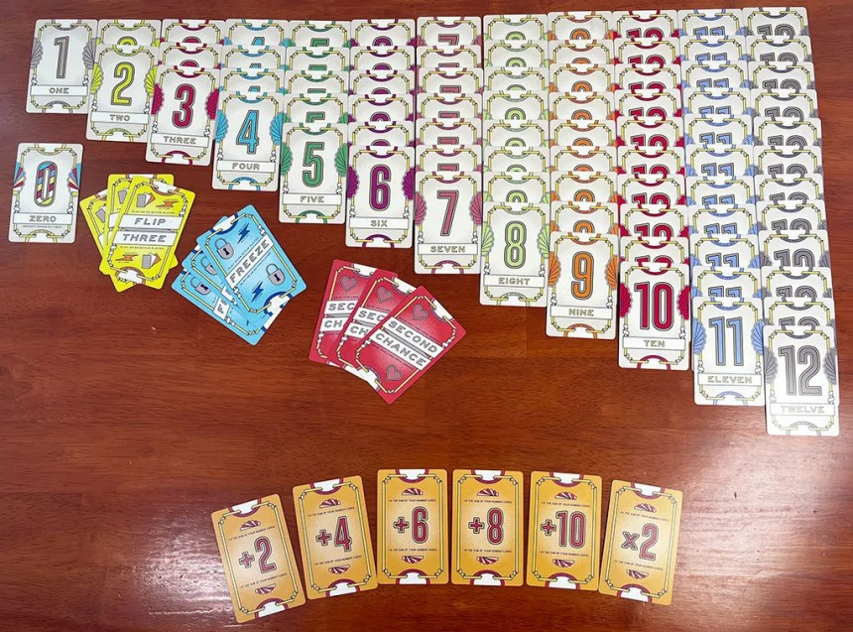
Game Overview
3
Goal : First player to reach 200+ points wins.
Turn Choice: Draw or Stop
Bust Mechanic: Drawing a duplicate of any number card causes the player to lose all points in the round
Small Simplifications made:
Immediate win once player crosses 200-point threshold
Excluded 15 Point bonus for 7 cards
Fixed special card policy
Notes:
This game is relatively simple mechanically, but somewhat complicated mathematically in terms of evaluating risk. Each player wants to reach 200 points.
On each turn, you really have 2 choices Draw or Stop. That’s important for the Q-learning table.
We have 1 – 1 card, 2- twos, 3- threes and so on up to 12. That means bigger numbers good, but risky because there’s more of them in the deck so higher probability of drawing.
We’ve got some special cards, Flip 3, which means you either draw 3 cards or you assign someone else to draw 3 cards. – I made a heuristic policy for this, to make the game run easier.
We have a Freeze, which ends someone’s turn in the round immediately – tricky to implement code wise, caused me problems.
We have a 2nd chance card, it’s important, if you draw a duplicate, and you have the second chance card, you’re still in the game for the round but it gets discarded.
Beyond that, some simple modifiers, +2, +4, +6. +8, +10, *2
I simplified some of the game, so we can focus on the stopping instead of the full commercial game itself.
I encourage playing the game, fun for the family and friends, drinking or not.

Slide 4
MDP Formulation
4
MDP Component | Flip 7 Implementation
State | Score bin, Cards Drawn, Score Gap Bin, Second Chance
Actions | Draw or Stop
Transition | Draw, Bust, Bank, Special Card effect
Reward | Banked Score reward, Position Reward, Bust Penalty, Win Bonus
Policy | Learned Q-Table Action Preference
def get_state(player: PlayerState, engine: Flip7RoundEngine,
player_idx: int) -> Tuple:
score_bin = get_score_bin(player.round_points)
cards_drawn = player.cards_drawn_count
has_second_chance = int(player.second_chance_available)
leading_idx = engine.get_leading_opponent(player_idx)
if leading_idx is not None:
leading_score = (engine.players[leading_idx].total_points +
engine.players[leading_idx].round_points)
my_score = player.total_points + player.round_points
raw_gap = leading_score - my_score # positive = behind
else:
raw_gap = 0
if raw_gap > 45: gap_bin = 3 # significantly behind
elif raw_gap > 15: gap_bin = 2 # moderately behind
elif raw_gap >= -15: gap_bin = 1 # roughly even
else: gap_bin = 0 # ahead
return (score_bin, cards_drawn, gap_bin, has_second_chance)
(Russell & Norvig, Artificial Intelligence: A Modern Approach, 2021)
Notes:
I modeled this game similar to our Pac-man homework assignment which was a Markov Decision Process.
The agent sees a simplified version of the game, Draw or Stop, receives a reward or negative reward, and updates its Q-values.
The design choices here are important. What information is important to track, and what information is noise.
What is enough to support learning, but small enough for tabular Q-learning.
This has impact as we’ll see later in the presentation.

Slide 5
Heuristic Agents
5
Agent | Stop Rule | Risk Profile | Baseline Result
Conservative | Stop at 18pts or 4 cards. | Low Risk | Lower Scoring, Safe
Balanced | Stop at 26 pts or 6 cards | Moderate Risk | Middle Baseline
Greedy | Stop at 30 pts or 6 cards | High Risk | Strongest Heuristic
def conservative_policy(player: PlayerState,
stop_threshold: int = 18,
max_cards: int = 4) -> str:
"""
Stops at a low score threshold or low card count.
Prioritizes safety over accumulation.
Empirical avg banking: 21.6 points per stop during 3 agent baseline testing.
"""
if player.round_points >= stop_threshold or \
player.cards_drawn_count >= max_cards:
return "STOP"
return "DRAW"

Slide 6
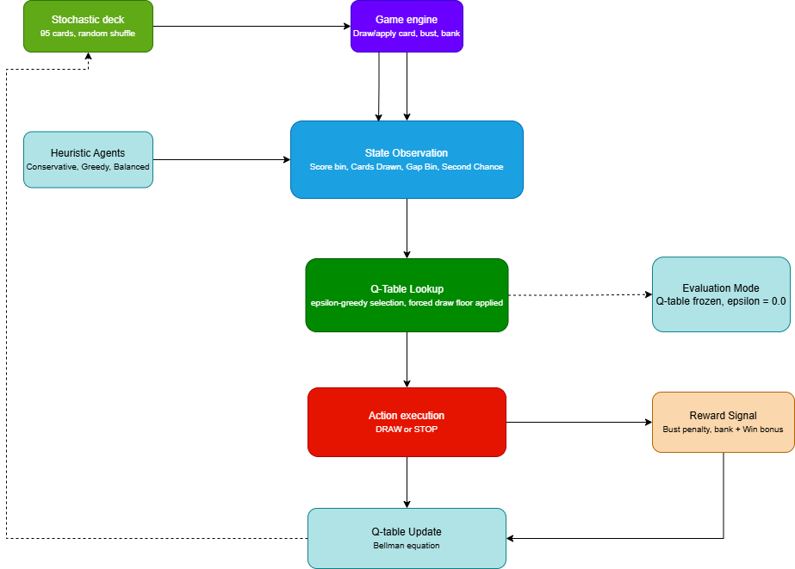
System Architecture
6
Notes:
This is the training loop. The system architecture is somewhat simplistic. Everything starts with our stochastic deck that is assembled.
The environment deals cards and manages the game. The agent observes a reduced state, looks up Q-values, chooses an action, receives a reward, and updates the Q-table. During training it explores with epsilon-greedy behavior.
As reminder, the epsilon-greedy behavior is like a dilemma explorer. Think pacman trying to figure out should I go with the best option I’ve found so far, or try a random option to see if its even better.
The more rounds, the less it explores.
During evaluation the Q-table is frozen so we can measure what it actually learned. In evaluation mode, epsilon move to 0, and it becomes greedy and never searches for a new option.

Slide 7
Q-Learning Agent Design
7
Design Choice | Value/ Structure | Reason
Algorithm | Tabular Q-Learning | Transparent – ease of use
State | Score_bin, cards drawn, Gap_bin, 2nd chance | Captures risk and position
Actions | Draw, Stop | Stopping Decision
Training | 10,000 Games | Training time
Learning Rate | Alpha = 0.7 | Faster Learning
Discount | y = 0.63 | Future Rewards
Exploration | Decay to 0.05 | Explore Early
----------------------------
# Hyperparameters
# ----------------------------
ALPHA = 0.7 # learning rate — aggressive updates from new experience
GAMMA = 0.63 # discount factor — slightly future-leaning
EPSILON = 1.0 # exploration rate — starts fully exploratory
EPSILON_DECAY = 0.9996 # decay per game — hits floor around game 8000
EPSILON_MIN = 0.05 # floor — agent never stops exploring entirely
(Watkins & Dayan, Machine Learning, 1992) (Jang et al., IEEE Access, 2019)
Notes:
The most important design choice was state abstraction. I originally tracked more exact information, but the Q-table became too sparse. I tried to track every card combination in a hand. Obviously, I didn’t understand state abstraction and my limitations with the training budget.
After achieving a .003 win rate, I adjusted.
So I moved to score bins, card-count tracking, gap bins, and a second-chance flag. That gave the agent enough information to make risk-aware decisions while keeping the table small enough to learn from repeated visits.

Slide 8
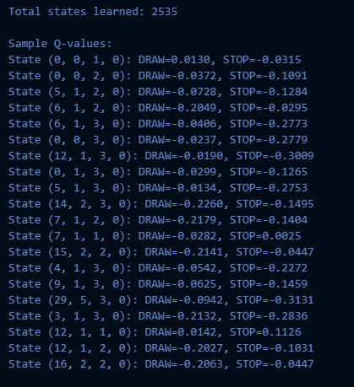
Q-Learning Agent Design
7
Design Choice | Value/ Structure | Reason
Algorithm | Tabular Q-Learning | Transparent – ease of use
State | Score_bin, cards drawn, Gap_bin, 2nd chance | Captures risk and position
Actions | Draw, Stop | Stopping Decision
Training | 10,000 Games | Training time
Learning Rate | Alpha = 0.7 | Faster Learning
Discount | y = 0.63 | Future Rewards
Exploration | Decay to 0.05 | Explore Early
(Watkins & Dayan, Machine Learning, 1992) (Jang et al., IEEE Access, 2019)
Notes:
The most important design choice was state abstraction. I originally tracked more exact information, but the Q-table became too sparse. I tried to track every card combination in a hand. Obviously, I didn’t understand state abstraction and my limitations with the training budget.
After achieving a .003 win rate, I adjusted.
So I moved to score bins, card-count tracking, gap bins, and a second-chance flag. That gave the agent enough information to make risk-aware decisions while keeping the table small enough to learn from repeated visits.

Slide 9
Q-Learning Agent Design
7
Design Choice | Value/ Structure | Reason
Algorithm | Tabular Q-Learning | Transparent – ease of use
State | Score_bin, cards drawn, Gap_bin, 2nd chance | Captures risk and position
Actions | Draw, Stop | Stopping Decision
Training | 10,000 Games | Training time
Learning Rate | Alpha = 0.7 | Faster Learning
Discount | y = 0.63 | Future Rewards
Exploration | Decay to 0.05 | Explore Early
def get_score_bin(round_score: int) -> int:
"""
Final tuned score bins.
Decision-aware score bins concentrated around heuristic thresholds.
Boundaries informed by empirical baseline avg banking points:
Conservative: 21.6, Balanced: 29.7, Greedy: 34.0
Anything over 49 collapsed into bin 7 — rarely reached, behavior obvious.
"""
if round_score <= 12: return 0 # just draw, no real decision
elif round_score <= 18: return 1 # approaching conservative threshold
elif round_score <= 23: return 2 # approaching balanced threshold
elif round_score <= 29: return 3 # approaching greedy threshold
elif round_score <= 36: return 4 # high risk zone
elif round_score <= 42: return 5 # very high
elif round_score <= 49: return 6 # extreme
else: return 7 # 50+ almost certainly stop
(Watkins & Dayan, Machine Learning, 1992) (Jang et al., IEEE Access, 2019)
Notes:
The most important design choice was state abstraction. I originally tracked more exact information, but the Q-table became too sparse. I tried to track every card combination in a hand. Obviously, I didn’t understand state abstraction and my limitations with the training budget.
After achieving a .003 win rate, I adjusted.
So I moved to score bins, card-count tracking, gap bins, and a second-chance flag. That gave the agent enough information to make risk-aware decisions while keeping the table small enough to learn from repeated visits.

Slide 10
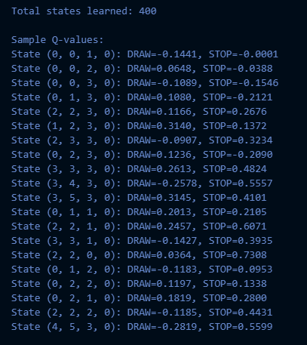
Q-Learning Agent Design
7
Design Choice | Value/ Structure | Reason
Algorithm | Tabular Q-Learning | Transparent – ease of use
State | Score_bin, cards drawn, Gap_bin, 2nd chance | Captures risk and position
Actions | Draw, Stop | Stopping Decision
Training | 10,000 Games | Training time
Learning Rate | Alpha = 0.7 | Faster Learning
Discount | y = 0.63 | Future Rewards
Exploration | Decay to 0.05 | Explore Early
Notes:
The most important design choice was state abstraction. I originally tracked more exact information, but the Q-table became too sparse. I tried to track every card combination in a hand. Obviously, I didn’t understand state abstraction and my limitations with the training budget.
After achieving a .003 win rate, I adjusted.
So I moved to score bins, card-count tracking, gap bins, and a second-chance flag. That gave the agent enough information to make risk-aware decisions while keeping the table small enough to learn from repeated visits.

Slide 11


Reward Function
8
Bank Reward
def compute_reward(points_banked: int, busted: bool,
score_gap: int,
win_threshold: int = 200) -> float:
"""
if busted:
if score_gap <= -45: return -0.6 # ahead by 45+ — greed tax
elif score_gap <= -20: return -0.45 # ahead by 20-44
else: return -0.3 # trailing or standard bust
score_component = points_banked / 50
position_component = score_gap / win_threshold
reward = 0.6 * score_component + 0.4 * (-position_component)
return min(reward, 1.0)
Bust Penalty
Situation | Penalty
Ahead by 45+ | -0.60
Ahead by 20-44 | -0.45
Even or trailing | -0.30
Win Bonus
(Barros et al., arXiv, 2020)
Notes:
This is pretty important and in retrospect, a bit of a flaw on my behalf. I went for a tiered reward structure. Originally, I had issues in testing with a super high rate of busting from just oversized draws.
I thought to curb that with a bust penalty. The reward function tried to balance three things: scoring points, understanding whether the agent was ahead or behind, and punishing busts. The idea was that busting while ahead should be punished more because it is reckless, while busting while behind should be punished less because risk-taking may be necessary. This reward design worked partially, but it also created the biggest finding of the project

Slide 12
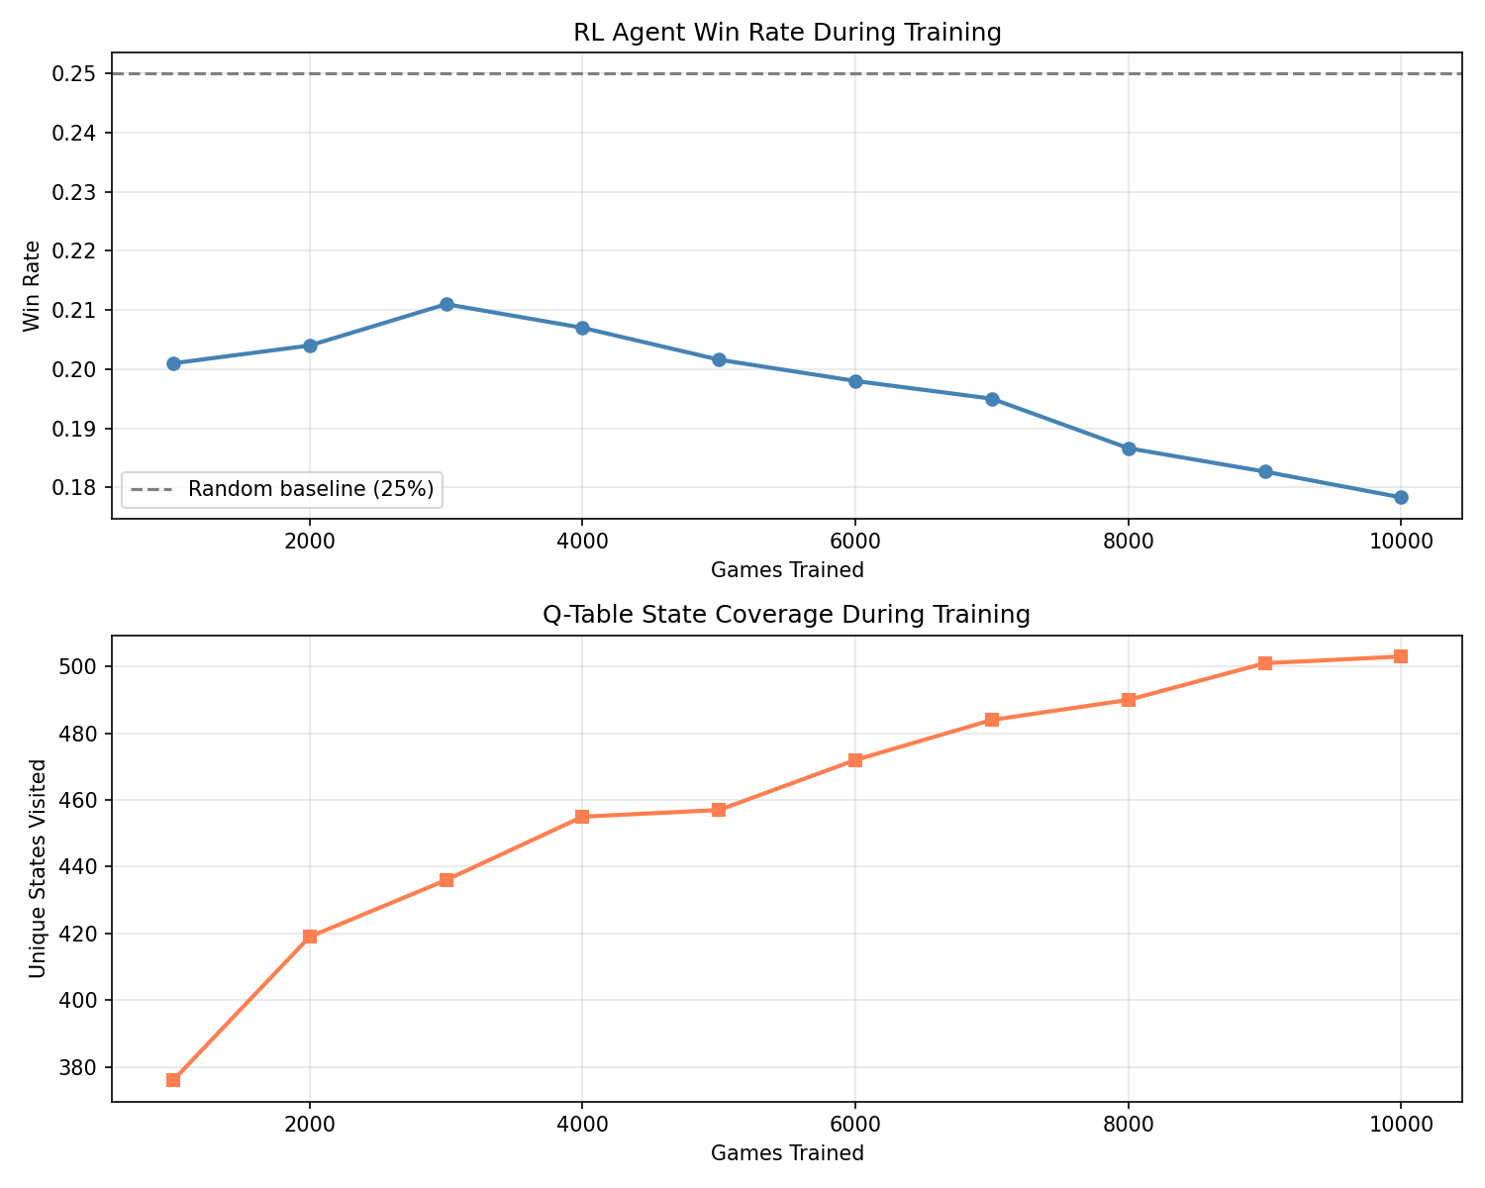
Training Results
9
Main Takeaways:
- State coverage increased over 10,000 games
Win rate did not steadily improve, actively preformed worse
Exploration floor reached near 8,000.
Notes:
This slide shows that the agent did learn a stable policy, but not necessarily a winning one.
State coverage improved across training, which means the Q-table was being populated.
However, the win rate did not climb above the heuristics.
That told me the issue was not just whether the model was learning, but what behavior the reward structure was teaching it.
Altogether – part of architecture good, Agent explored more of the Q-table
Learning stabilized
Agent shifted to exploitation late, but it did not hit baseline expectations.

Slide 13
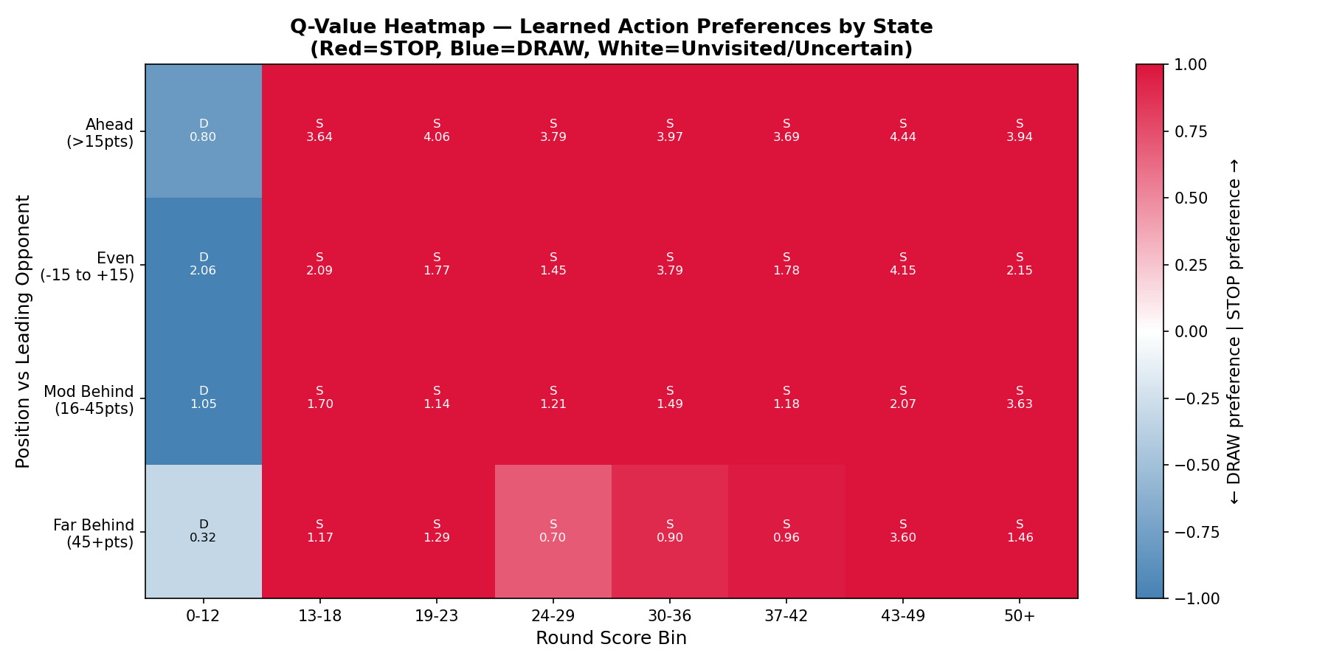
Evaluation Results
10
Agent | Win Rate | Avg Banked | Bust Rate
RL Agent | 0.153 | 18.4 | 0.110
Conservative | 0.266 | 21.6 | 0.047
Greedy | 0.327 | 33.3 | 0.091
Balanced | 0.254 | 29.9 | 0.077
Notes:
The evaluation results show the clearest outcome.
The RL agent had the lowest win rate and also banked the fewest points per stop.
Interestingly, it also had the highest bust rate, which suggests it was not simply playing safely all the time.
The better interpretation is that it was not scoring efficiently. Greedy accepted risk but banked enough points to reach 200 faster.
I think my rewards were too conservative, and the bust rate is high due to the greedy epsilion explore rate, but I simply had it banking too early.
We’ll discuss more later.

Slide 14
Statistical Evaluation
11
Detailed Baseline Results over 5000 games:
Metric Conservative Greedy Balanced
---------------------------------------------------------------
wins 810 1297 1105
busts 7019 17105 13708
stops 33402 22442 25720
total_banked 721419 746504 767765
---------------------------------------------------------------
Avg banked: 29.8 Bust rate: 0.077 Stop rate: 0.144 — Balanced_2
Avg banked: 21.6 Bust rate: 0.047 Stop rate: 0.223 — Conservative
Avg banked: 33.3 Bust rate: 0.091 Stop rate: 0.119 — Greedy
Avg banked: 29.9 Bust rate: 0.077 Stop rate: 0.144 — Balanced
Heuristic Baseline Results over 5000 games
(4 players):
Balanced_2 0.358 win rate
Conservative 0.149 win rate
Greedy 0.262 win rate
Balanced 0.231 win rate
RESULTS SUMMARY
==================================================
RL Agent win rate: 0.153
RL bust rate/round: 0.110
RL avg pts banked: 18.4
Statistical Test (k=10 folds):
RL mean win rate: 0.167 +/- 0.028
Greedy mean win rate: 0.345
Conservative mean: 0.253
Balanced mean: 0.279
95% CI: (0.146, 0.189)
t-statistic: -11.4147
p-value (two-sided): 0.0000
p-value (one-sided): 0.0000
Significant (p<0.05): True
Notes:
So, the requirement here was to make sure this hit a rigorous test. I end up going for a 10-fold paired t-test.
Each fold retrained the RL agent with a different seed and compared it against the greedy heuristic.
The results were so poor, during testing, I added in the other heuristics to see if the agent was catching up.
As you can see, Conservative definitely performed better when you add the RL Agent.
Pvalue is below 0.0001, so I reject the null hypothesis. The direction is a bit brutal when you see the t-statistic.
It means the difference favored greedy not the RL agent. I think that’s due to the rewards.
Let’s get into that discussion

Slide 15
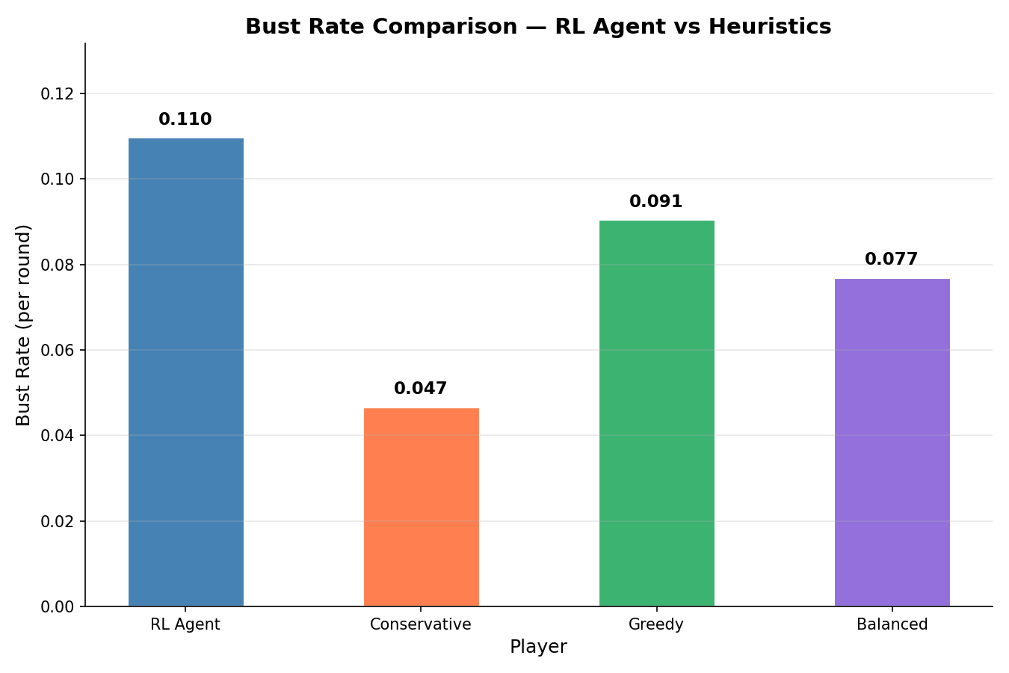
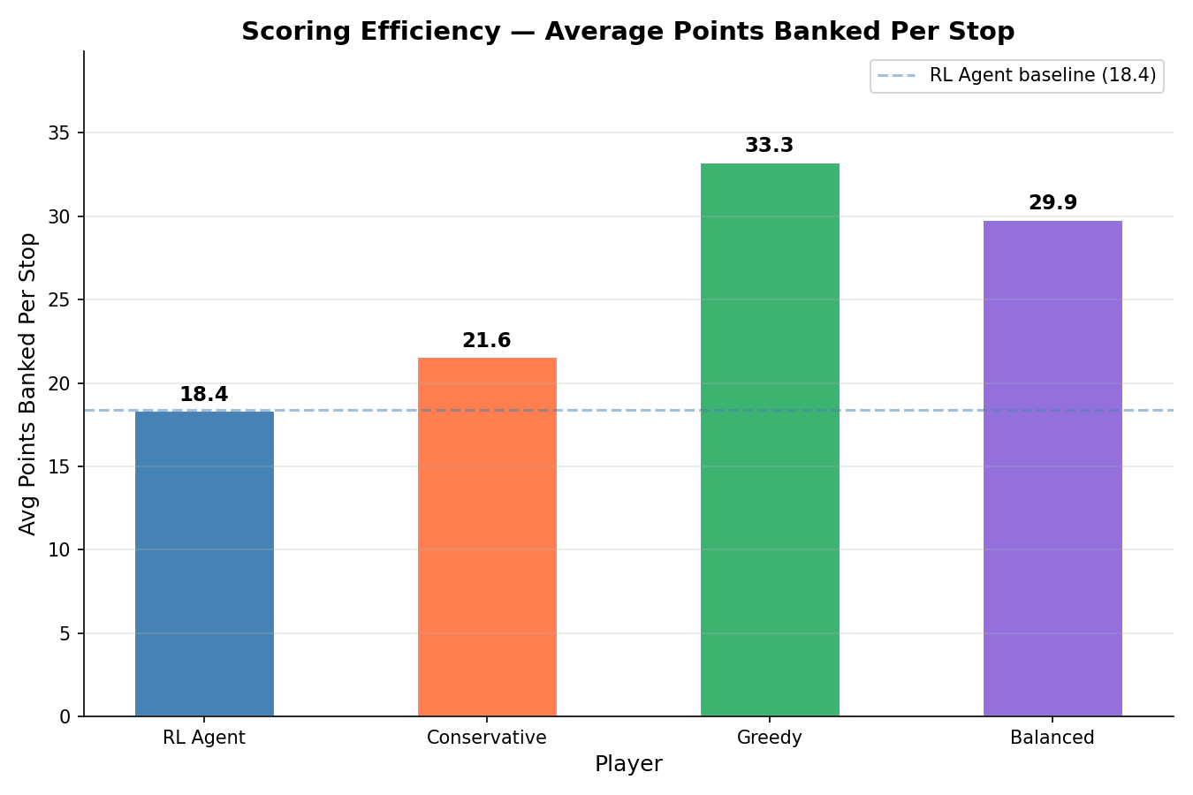
Discussion/Takeaways
12
My reward function is flawed
My agent was actively banking well below the competition
My Greedy heuristic may not be as greedy as it should be.
State Abstraction has limitations
Balanced_2 Heuristic had issues during testing phase
Notes:
The reward function punished mistakes immediately, but the reward for winning came only at the end of the game. That made safe banking more consistently rewarding than taking the risk needed to win.
Bust rate is way too high compared to the other heuristics.
Banking is way too low for points
State abstraction – Big lesson there. Tabular Q-learning has some efficiency issues. I probably could’ve continue the test, with original state, but would’ve needed to seriously increase the amount of steps.
Terrible for reading the logs and understanding what is happening. There’s literature on Q-networks but I haven’t wrapped my head around it fully.
Balanced 2 – Had some anomalies. I would certainly revisit the engine to see if I made a flub in the engine, it doesn’t make sense the win rate it has.

Slide 16
Question #1
13
What aspect of AI did you find most technically challenging in completing this term project? State Abstraction
Notes:
Original state tracked individual cards drawn
14 number bins × uncapped cards drawn × 4 gap bins = 100,000+ possible states
10,000 training games produced only ~2,500 visited states — agent couldn't build reliable Q-values from 1-2 visits per state
Solution: decision-aware score binning reduced state space to 513 well-visited states, but cost card-level risk reasoning

Slide 17
Question #2
14
What aspect of AI do you think you learned the most about over the course of the project? Heuristics
Notes:
Building and tuning three distinct policies showed how small threshold changes produce measurable behavioral differences Running 5,000-game baselines revealed game dynamics that couldn't be predicted theoretically — Greedy's aggression is structurally rewarded by the deck composition Heuristic tuning directly informed the RL agent's state bin boundaries — the learning wasn't separate, it fed the whole project
Heuristics more so because I had fun creating them. I had fun running the simulations and seeing how changing different parts of the policies could affect the balance of the game.

Slide 18
Question #3
15
What is your top priority for future work, if you were to continue this project as a research project or in independent study?
Notes:
Too many items to choose here. 1st, I need to see what was going on with the Balanced 2 heuristic.
Balanced_2 anomaly remains unresolved after randomizing turn order — three hypotheses exist but none confirmed.
First priority before any further training Transition to Deep Q-Networks — confirmed by data science peers and supported by the literature.
DQN is supposed to directly solve it, but I don’t understand it yet.

